Slide 1

Intro to VueJS
Overview, Installation, the Vue Instance, Template
SoftUni Team
Technical Trainers
Software University
https://softuni.bg

Slide 2
Table of Contents
Introduction
What is VueJS?
Features
Installation
CDN & Local
CLI
The Vue Instance
Template Syntax
2

Slide 3
Have a Question?
sli.do #js-frameworks

Slide 4

Introduction
VueJS Overview

Slide 5
What is VueJS ?
Progressive framework for building user interfaces
The core library is focused on the view layer only
Perfectly capable for creating Single-Page Applications
Created by Evan You (former employee @ Google)
Combines the best from both React and Angular
5

Slide 6
VueJS Features
Lightweight – 16kb and very fast performance
Virtual DOM – good in terms of optimization
Data Binding – one and two-way
Components – reusable HTML
Directives – v-if, v-else, v-for etc.
Computed Properties & Watchers – listen to changes
Vue CLI – build & compile easily

Slide 7






VueJS Users

Slide 8
VueJS vs React
Vue
Has Virtual DOM
Template based approach
Vue-cli/CDN/npm
Less Popular
React
Also has Virtual DOM
JSX approach
Create-react-app
More Popular
8

Slide 9
VueJS vs Angular
Vue
Has Directives & CLI
Natively uses JavaScript
Smaller file size
Does not have build-in features
Angular
Also has Directives & CLI
Natively uses TypeScript
Bigger file size
Has a lot of build-in features
9

Slide 10

Installation
CDN, JSFiddle, IDE

Slide 11
Resources
Visit the official website
Documentation
Vue API
https://vuejs.org/
https://vuejs.org/v2/guide/
https://vuejs.org/v2/api/
11

Slide 12
Installation
Check out the official docs
Simply download and include with a script tag
Vue will be registered as a global variable
Or use the CDN
https://vuejs.org/js/vue.js
Development Version
<script src="https://cdn.jsdelivr.net/npm/vue">
</script>
12

Slide 13
JS Fiddle
JS Fiddle is an online platform where you can test JavaScript, CSS, HTML and etc.
<script src="https://cdn.jsdelivr.net/npm/vue">
</script>
<div id="app">
<h1>
{{ title }}
</h1>
</div>
new Vue({
el: '#app',
data: {
title: 'Hello World!'
}
});
13

Slide 14
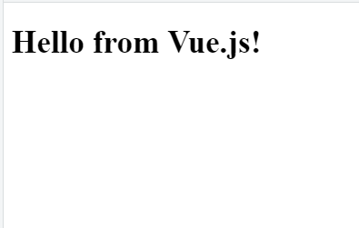
JS Fiddle (2)
Simple hit [Ctrl] + [Enter] and test the application
14

Slide 15
NPM Installation
NPM is the recommended installation method when building large scale applications with Vue
It pairs nicely with module bundlers such as Webpack or Browserify
Current v2.6.11
$ npm install vue
Current CLI v4.2.3
15

Slide 16


IDE Support and Vue CLI
You can use Visual Studio Code, WebStorm or even just JS Fiddle
Install "Vetur" extension in VS Code for tooling
VS Code and WebStorm fully support the Vue CLI
16

Slide 17

The Vue Instance
Interacting with the DOM

Slide 18
Creating a Vue Instance
Every Vue application starts by creating a new instance
Vue's design is partially inspired by MVVM
vm – short for ViewModel
var vm = new Vue({
// options });
Use ES5 when no transpilation occurs

Slide 19
Interacting with the DOM
Vue interacts with the DOM via templates
Connect with the template
<div id="app">
<h1>{{ title }}</h1>
</div>
The {{ }} syntax is called interpolation
new Vue({
el: '#app',
data: { title: 'Hello!' }
});
Pass a query selector

Slide 20
Multiple Instances
More than one instance is possible in one template
<body>
<div id="first">
<p>First Vue</p>
</div>
<p> In Between </p>
<div id="second">
<p>Second Vue</p>
</div>
var vm1 = new Vue({
el: '#first',
data: { } });
var vm2 = new Vue({
el: '#second',
data: { } });

Slide 21
Data and Methods
When a Vue instance is created, it adds all the properties found in the data object
That is called Vue's reactivity system
When the value of a property changes, the view will "react"
Updating to match the new values
21

Slide 22
Reactivity Example
var data = { name: 'Peter', age: 22 };
// The data is added to the instance
var vm = new Vue({ data: data });
// Setting the property on the instance
// affects the original data and vise-versa
vm.age = 23;
data.age; // 23
22

Slide 23
Re-rendering the DOM
When data changes the view will re-render
Properties react only if they existed when the instance was created
vm.email = 'mike@gmail.com';
Does NOT trigger a UI update
23

Slide 24
Prefixed Properties
Vue exposes a number of instance properties
Prefixed with '$'
Differentiate from user-defined properties
$el - the root DOM element that the Vue instance is managing
$data - the data object that the Vue instance is observing
$props - current props a component has received
$options - instantiation options
Many more at: https://vuejs.org/v2/api/#Instance-Properties

Slide 25

Template Syntax
Interpolation, Attributes, Expressions

Slide 26
How It Works?
Vue.js uses an HTML-based template syntax
Declaratively bind the rendered DOM
Applies the minimal amount of DOM manipulations
Interpolates data by using the curly braces {{ }}
The syntax interpreters the data as plain text
26

Slide 27
Text Interpolation
One-way data binding
new Vue({
data: {
msg: 'Sample msg' }
});
<div> {{ msg }} </div>
Updated when the property changes
27

Slide 28
Using V-once Directive
You can also perform one-time interpolations
A DOM element with v-once does not update on data change
<ul>
<li>{{ firstTxt }}</li>
<li>{{ secondTxt }}</li>
<li v-once>{{ thirdTxt }}</li>
</ul>
28

Slide 29

Attributes
Mustaches cannot be used inside HTML attributes
Instead use v-bind directive
<a href="{{ linkToHome }}"> Go to Home </a>
<a v-bind:href="linkToHome"> Go to Home </a>
29

Slide 30
JavaScript Expressions
Vue supports JS expressions inside data bindings
// Expression
{{ 5 + 1 }}
// Ternary Operator
{{ isValid ? 'Valid' : 'Not Valid' }}
// Array Operations
{{ items.split(' ').reverse().join('|') }}
30

Slide 31
Invalid Expressions
Does NOT support the following
// Statements
{{ var text = 'Hello' }}
// Flow Control
{{ if (isValid) { return 'Message' } }}
31

Slide 32

CLI Project Environment
Single-File Templates

Slide 33
The Vue CLI
The Vue CLI is a powerful tool
Webpack, Babel, Single-File Templates
Webpack bundles files during build process
Babel transpiles the ES6 code
Each component has it's own .vue file also called a Single-File Template
33

Slide 34
Single-File Template
The <template> is the component's HTML
<template>
<div>
<h1>Vue CLI</h1>
<p>Root Component</p>
<button @click="counter++">
Value {{ counter }}
</button>
</div>
</template>
Each template must have a root element
34

Slide 35
Single-File Template
The <script> is the component's declaration and other imports
export default {
// Use "import" to include other scripts
data: function() {
return {
counter: 0
}
}
}
35

Slide 36
Single-File Template
The <style> applies global styling by default
<style>
div {
background-color: gray;
margin: 20px;
padding: 35px;
border: 2px solid black;
}
</style>
Applies the style on ALL div elements
36

Slide 37
Scoping Styles
Add the "scoped" attribute
Applies style encapsulation to a single component
Similar to the Shadow DOM in Angular
<style scoped>
.example {
color: red;
}
</style>
37

Slide 38
Global Registration
Globally registered components can be used inside the <template> of any root Vue instance
Can be registered inside main.js
Use the import syntax to include it
import HeaderComponent from './components/Header'
Vue.component('app-header', HeaderComponent)
38

Slide 39
Local Registration
Locally registered components can ONLY be used inside the template of the current Vue instance
<script>
import HeaderComponent from './components/Header'
export default {
components: {
'app-header': HeaderComponent
}
}
</script>
Can also be appHeader
39

Slide 40
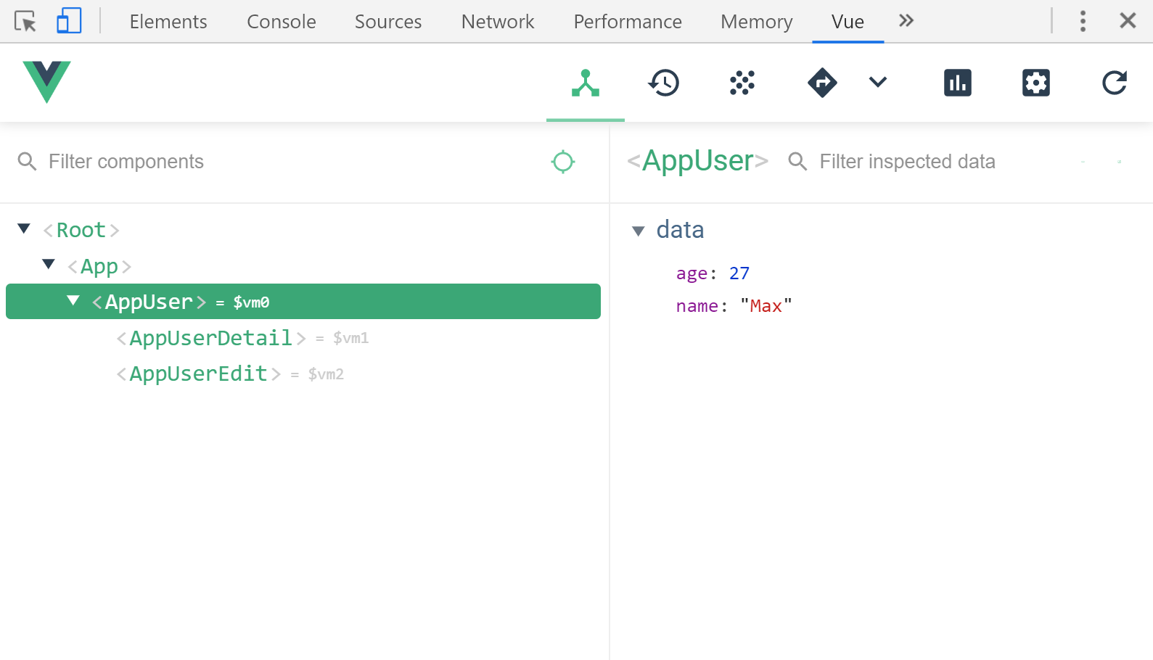
Vue.js Devtools
Install the official devtools for inspecting Vue elements
Chrome download link
40

Slide 41

Summary
…
…
…
VueJS is a progressive framework
Very lightweight and easy to install
Every Vue app has at least one instance
var vm = new Vue({
el: '#app',
data: { title: 'App' } });

Slide 42
Questions?
Notes:
42

Slide 43












SoftUni Diamond Partners

Slide 44




SoftUni Organizational Partners

Slide 45
Trainings @ Software University (SoftUni)
Software University – High-Quality Education, Profession and Job for Software Developers
softuni.bg, softuni.org
Software University Foundation
softuni.foundation
Software University @ Facebook
facebook.com/SoftwareUniversity
Software University Forums
forum.softuni.bg
45
Notes:
45

